Slide 1

Software Design (swD392)
Ch06 – Use Case Modeling

Slide 2
Main Contents
Requirement Modeling
Use Cases
Identifying Use Cases
Documenting Use Cases
Activity Diagrams

Slide 3
Requirement Modelling
﻿The requirements of a system describe
﻿What the user expects from the system
﻿What the system will do for the user
﻿When defining the requirements of a system
The system should be viewed as a black box. O﻿nly the external characteristics of the system are considered
﻿Both functional and nonfunctional requirements need to be considered
﻿Requirements modeling consists of requirements analysis and requirements specification

Slide 4
Requirement Modelling ﻿Requirements Analysis
﻿The software requirements describe the functionality that the system must provide for the users.
﻿﻿﻿Requirements analysis involves analyzing the requirements by
Interviewing user
Analyzing the existing system(s)
﻿Understanding and documenting the current system
﻿Determining which features of the current system should be automated and which should remain manual
Discussing with users what functions could be done differently when the system is automated.

Slide 5
Requirement Modelling ﻿Requirements Specification 1/2
﻿﻿The document that needs to be agreed on by the requirements analysts and the users.
﻿Starting point for the subsequent design & development
﻿Both functional requirements & nonfunctional requirements need to be specified
﻿A functional req. describes the functionality the system must be capable of providing in order to fulfill the purpose of the system
﻿Functionality the system needs to provide
﻿Input to the system from the external environment
﻿Output to the external environment
﻿What stored information the system reads or updates
﻿A nonfunctional requirement: quality attribute, or quality-of-service goal that the system must fulfill

Slide 6
Requirement Modelling ﻿Requirements Specification 2/2
﻿﻿Quality Attributes for a well-written Software Requirement Specification (SRS)
Correct
Complete
﻿Unambiguous
﻿Consistent
﻿Verifiable
﻿Understandable by non-computer specialists
﻿Modifiable
﻿Traceable

Slide 7
Use Cases
The use case model describes the functional requirements of the system in terms of the actors & use cases
﻿The system is treated as a black box (﻿dealing with what the system does in response to the actor’s inputs)
﻿Functional requirements are described in terms of actors, which are users of the system, and use cases
﻿A use case (UC) defines a sequence of interactions between one or more actors and the system
﻿A use case always starts with input from an actor
﻿Typically consists of a sequence of interactions between the actor and the system
﻿Each interaction consists of an input from the actor followed by a response from the system
﻿An actor provides inputs to the system and the system provides responses to the actor﻿

Slide 8
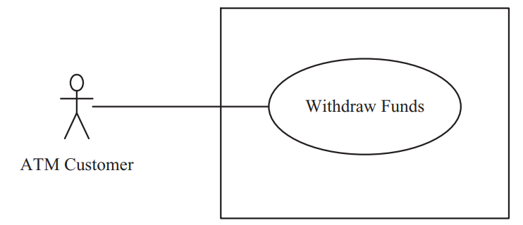
Use Cases Simple banking example
﻿An automated teller machine (ATM) allows customers to withdraw cash from their bank accounts
﻿The Withdraw Funds use case describes the sequence of interactions between the ﻿customer and the system
The use case starts when the customer inserts an ATM card into the card reader,
Then responds to the system’s prompt for the PIN,
And eventually receives the cash dispensed by the ATM machine

Slide 9
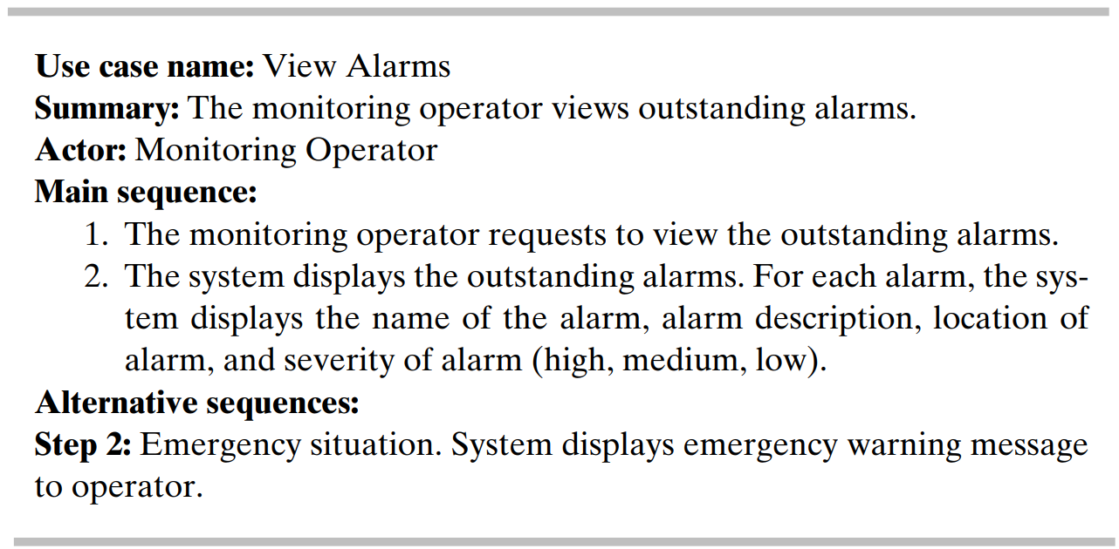
Use Cases ﻿Emergency Monitoring System
﻿As an example of a very simple use case, consider View Alarms from the Emergency Monitoring System. There is one actor, the Monitoring Operator, who can request to view the status of all alarms

Slide 10
Use Cases What are actors?
﻿An actor characterizes an external user (i.e., outside the system) that interacts with the system
﻿The only external entities that interact with the system
﻿Actors are outside the system and not part of it
﻿A user is an individual, whereas an actor represents the role played by all users of the same type
There are other types of actors in addition to or in place of human actors: external systems, I/O devices, or timers

Slide 11
Use Cases Sample actors
Users
Homeowners are actors on HOLIS system
Authors are actors on a word processing system
Other systems or applications
HOLIS Control Switch is an actor on the HOLIS Central Control Unit
A device
Lights
Printer

Slide 12
Use Cases Identifying actors
﻿Following are some questions you might ask to help user representatives identify actors
Who (or what) is notified when something occurs within the system?
Who (or what) provides information or services to the system?
Who (or what) helps the system respond to and complete a task?

Slide 13
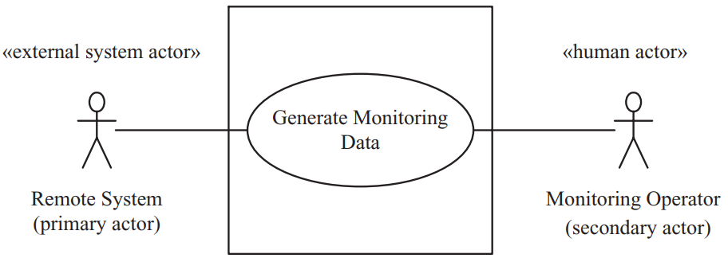
Use Cases ﻿Primary vs secondary actors
﻿﻿A primary actor initiates a use case. ﻿Thus, the use case starts with an input from the primary actor to which the system has to respond (gain value from the UC)
﻿Other actors, referred to as secondary actors, can participate in the use case

Slide 14
Identifying Use Cases
A use case (UC) describes a sequence of interactions between a system and an external actor that results in the actor being able to achieve some outcome of value
In this way, the functional requirements of the system are described in terms of the UCs, which constitute functional specification of a system.
To determine the UCs in the system, it is useful to start by considering the actors and the interactions they have with the system.
When developing UCs, it is important to avoid a functional decomposition in which several small UCs describe small individual functions of the system rather than describe a sequence of events that provides a useful result to the actor

Slide 15
Identifying Use Cases Use case considering and naming
Questions to consider when identifying use cases
What will the actor use the system for?
Will the actor create, store, change, remove, or read data in the system?
Will the actor need to inform the system about external events or changes?
Will the actor need to be informed about certain occurrences in the system?
The names of use cases are always written in the form of a verb followed by an object.
Select strong, descriptive names to make it evident from the name that the use case will deliver something valuable for some user.

Slide 16
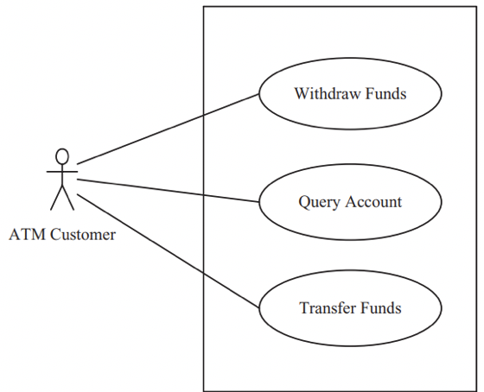
Identifying Use Cases Simple Banking Example
In addition to withdrawing cash from the ATM, the ATM Customer actor is also allowed to query an account or transfer funds between two accounts.
Because these are distinct functions initiated by the customer with different useful results, the query and transfer functions should be modeled as separate UCs, rather than being part of the original UC

Slide 17
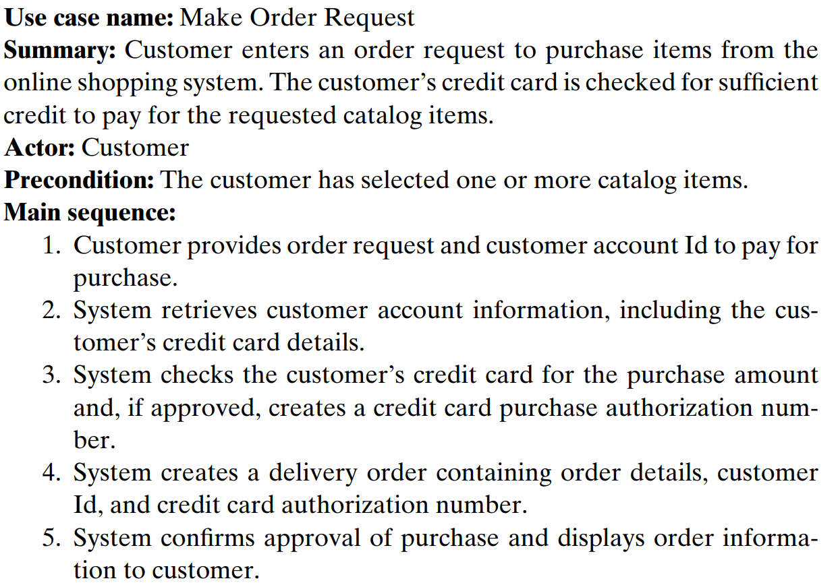
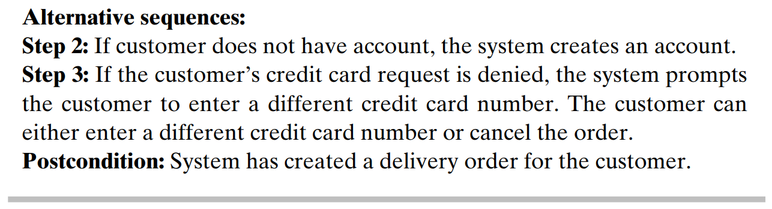
Documenting Use Cases
UC Spec
﻿Use case name
﻿Summary
﻿Dependency
Actors
﻿Preconditions
﻿Main sequence
﻿Alternative
sequences
﻿Postcondition

Slide 18
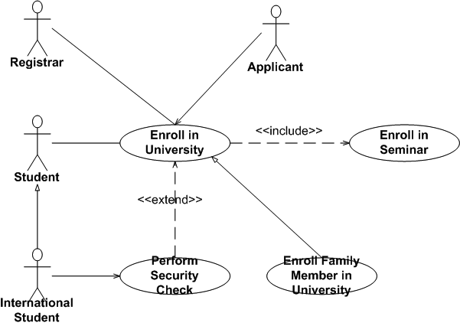
Documenting Use Cases Use Case Relationships
UC Relationships
Generalization
Include: mandatory
Extend: optional

Slide 19
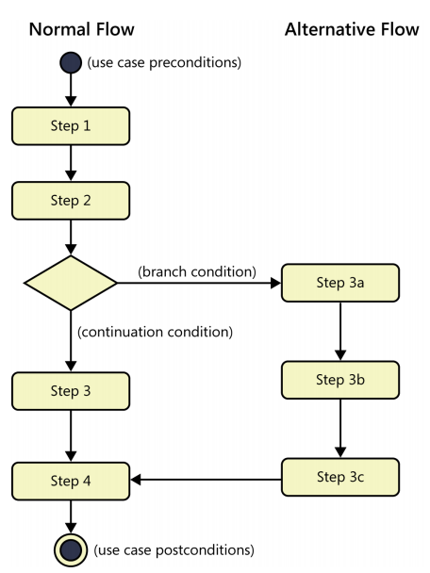
Activity Diagrams 1/2
An activity diagram can be used to represent the sequential steps of a UC, including the main sequence and all the alternative sequences
Depicting the flow of control & sequencing among activities
Shows the sequence of activities, decision nodes, loops, and even concurrent activities

Slide 20
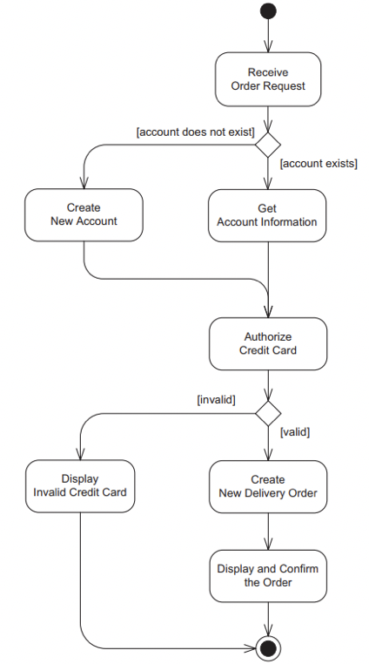
Activity Diagrams 2/2
An activity node can be used to represent one or more sequential steps of the UC
To depict a use case, a subset of the activity diagram capabilities is sufficient
Activity diagrams can also be used to depict sequencing among UCs.

Slide 21


